Slide 1
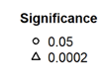
Ring porous
Diffuse porous
April T_{max}
+
SCBI
SCBI
Chronology number
HF
HF
*
Notes:
SCBI: 119-128, 195—196
HF: 31-32, 147-148

Slide 2
Ring porous
Diffuse porous
April T_{max}
+
SCBI
SCBI
Chronology number
HF
HF
*
Notes:
Tmin
SCBI: 119-128, 195—196
HF: 31-32, 147-148

Slide 3
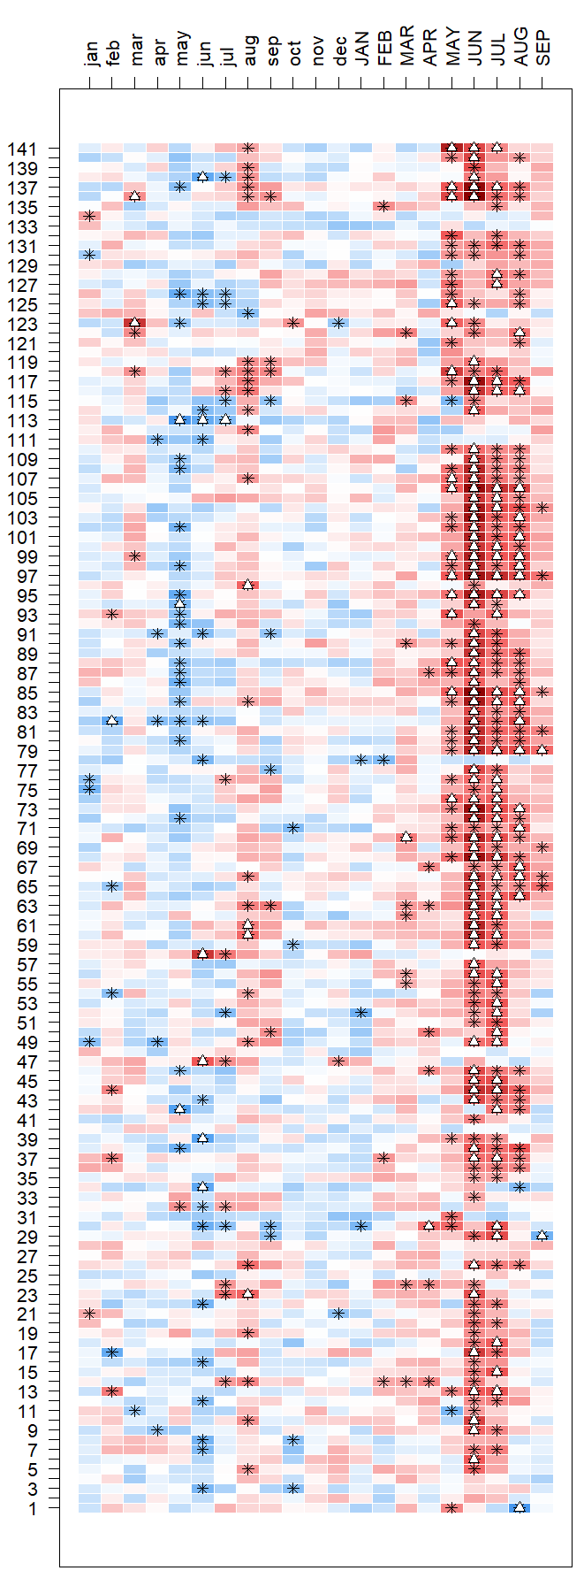
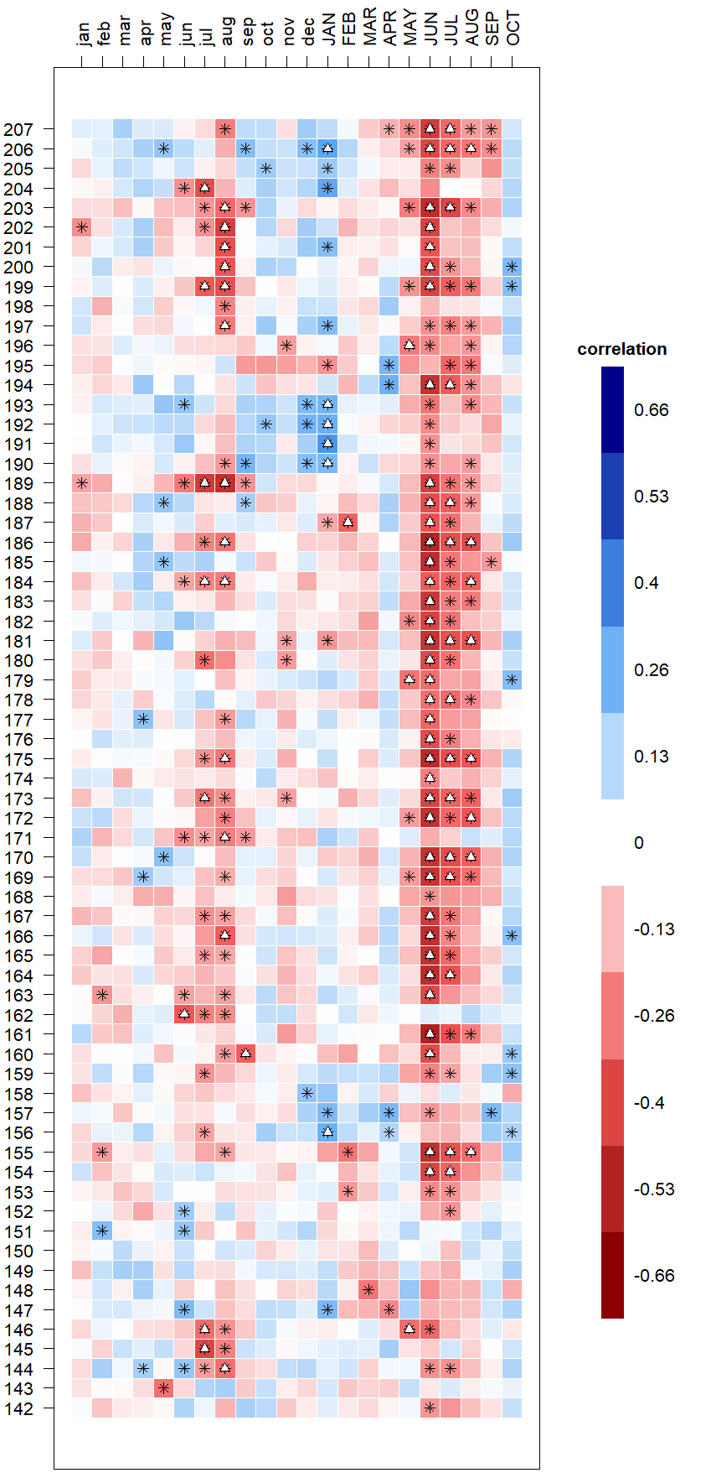
Ring porous
Diffuse porous
April T_{max}
+
SCBI
SCBI
Chronology number
HF
HF
*
Notes:
Tmin

